Slide 1
Machine Learning and the Future of Work
NEIL LAWRENCE
Department of Computer Science and SITraN
@lawrennd
Notes:
Challenges
Introduce self
Alphago impressive but requires heavy compute.
More games of go than any human
And yet still Lee managed to win a match.

Slide 2
GLOBAL INFORMATION STORAGE CAPACITY IN OPTIMALLY COMPRESSED BYTES
Notes:
Superhuman performances are being driven by ML
Vision, Speech, Translation
Lots of process, but driven by availability of data.
Methodologies have not progressed a great deal since late 1990s

Slide 3
Notes:
Historical Analogy
Thomas Newcomen South West England
1712 Steam Engine

Slide 4
Coal
Google
Facebook
Amazon
Tin
Startups

Slide 5
Notes:
James Watt Separate Condensor 1760s

Slide 6
Outline of the DeepFace architecture. A front-end of a single convolution-pooling-convolution filtering on the rectified input, followed by three locally-connected layers and two fully-connected layers. Color illustrates feature maps produced at each layer. The net includes more than 120 million parameters, where more than 95% come from the local and fully connected layers.
Source: DeepFace
Notes:
Modern Inference Engine
120 million parameters, 1 billion images, near human performance

Slide 7
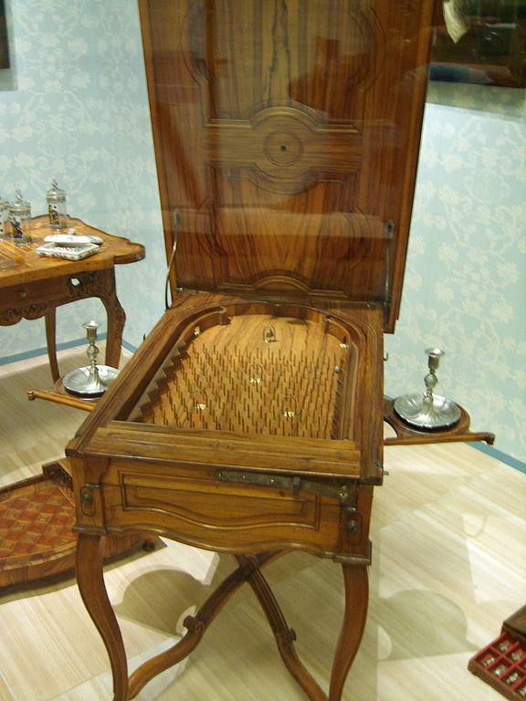
Notes:
Internal structure of the machine like layers of pins
Initial state of machine.
Moving pins around to fix

Slide 8
Yes
No

Slide 9
Yes
No

Slide 10
B
A
Notes:
All possible paths!

Slide 11
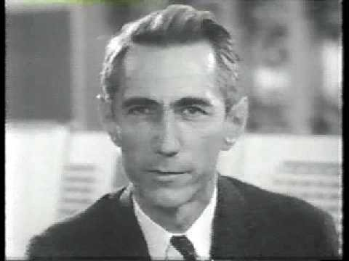

Slide 12
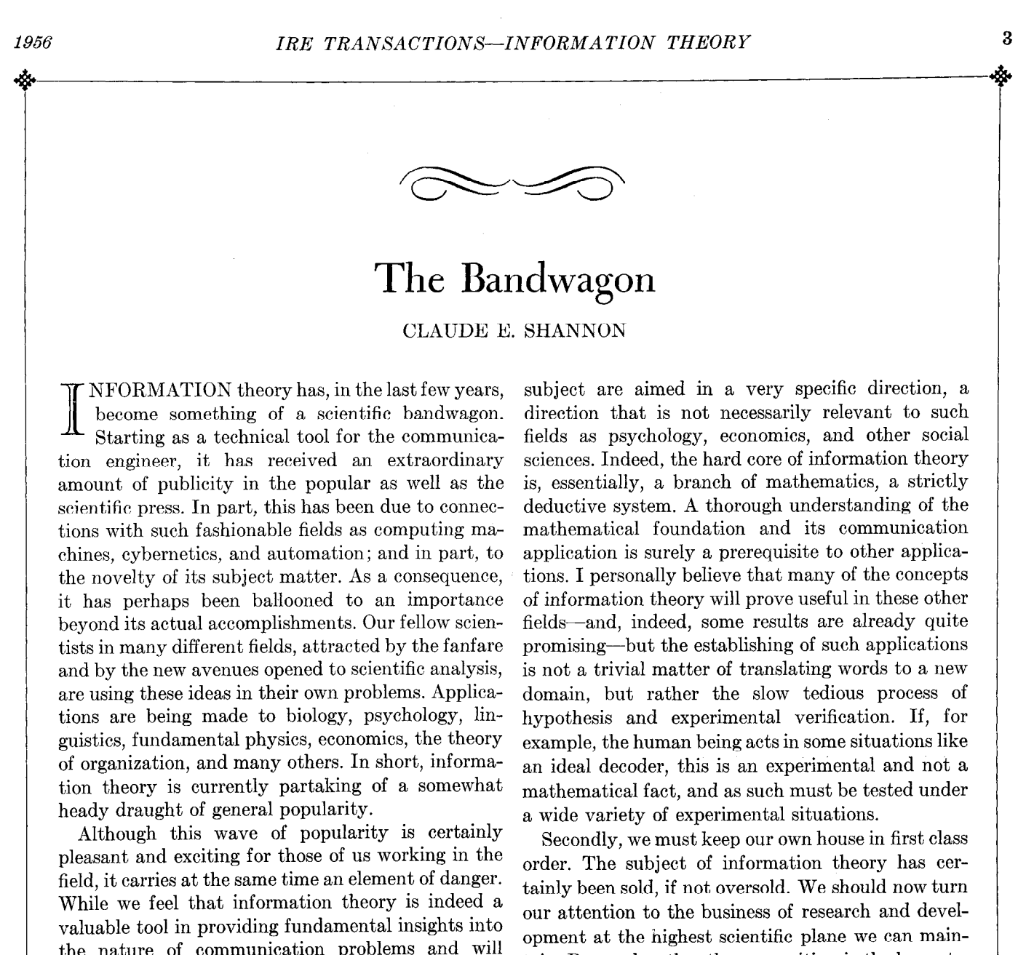

Slide 13

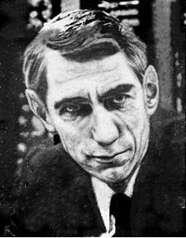

~10 gigaflops
10
~1 gigabit per second
~1000 teraflops?
$${10}^{13}$$
~100 bits per second?

Slide 14
Thank you
Neil Lawrence
http://inverseprobability.com
@lawrennd
Notes:
Thank you.

